Slide 1
Red Black Trees
Adeem Ali Anwar

Slide 2
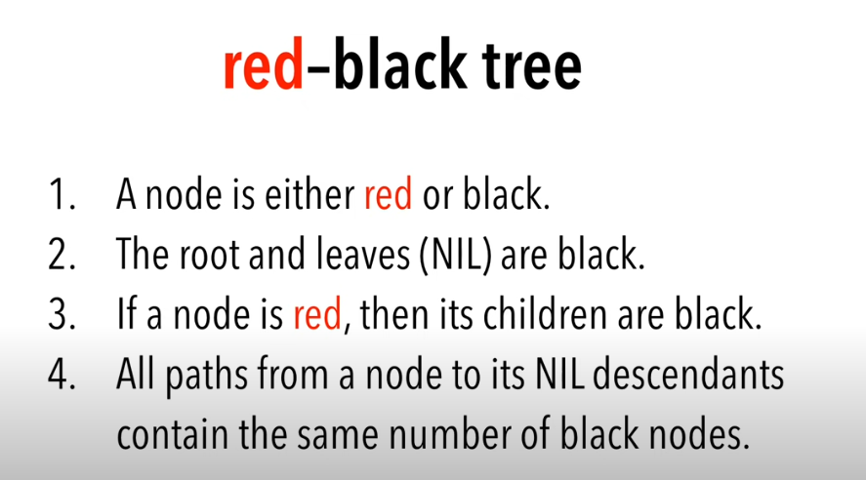
Basic Introduction

Slide 3
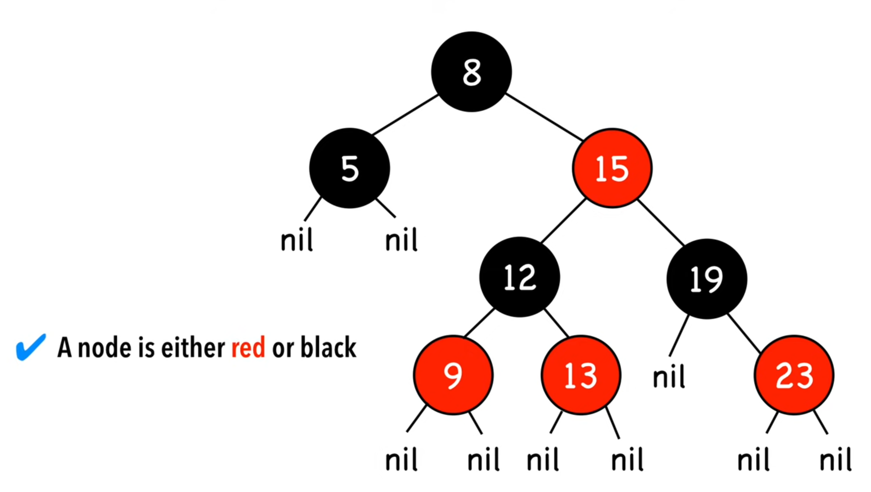
Point 1

Slide 4
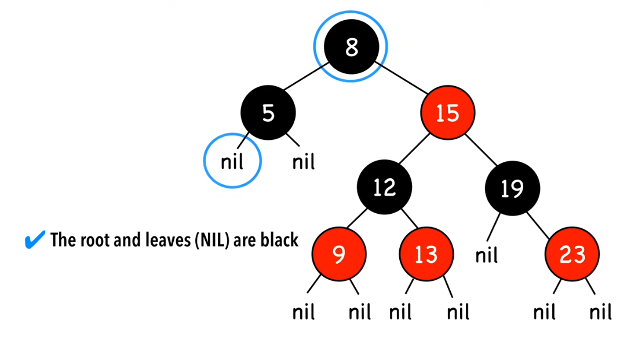
Point 2

Slide 5
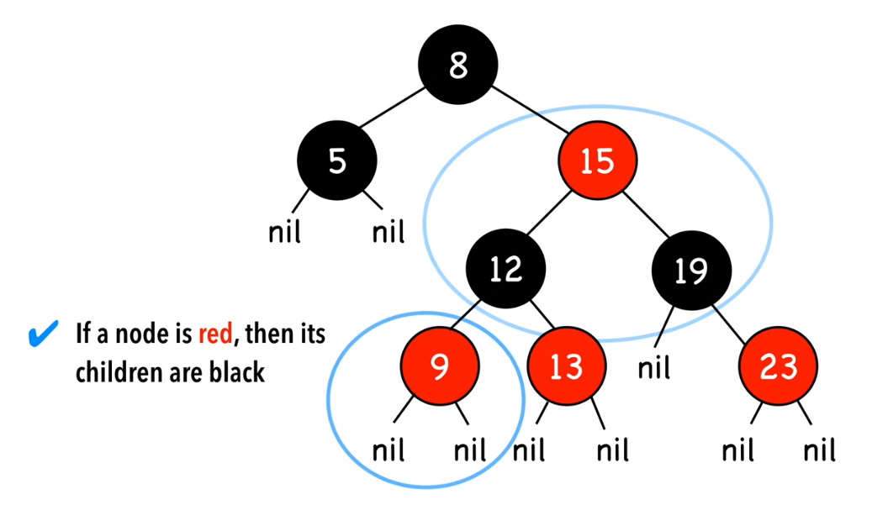
Point 3

Slide 6
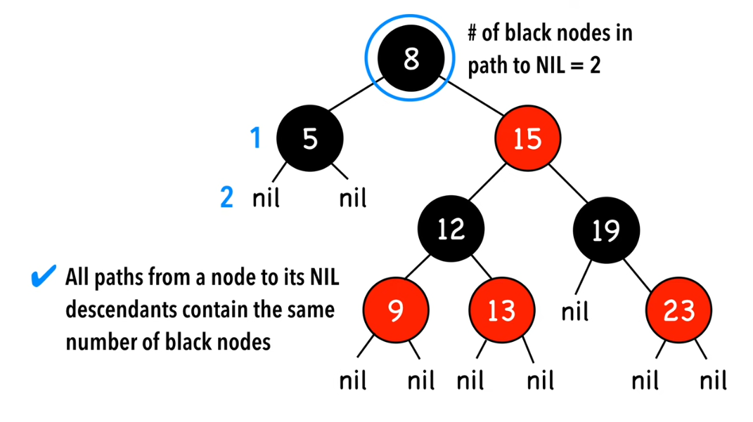
Point 4

Slide 7
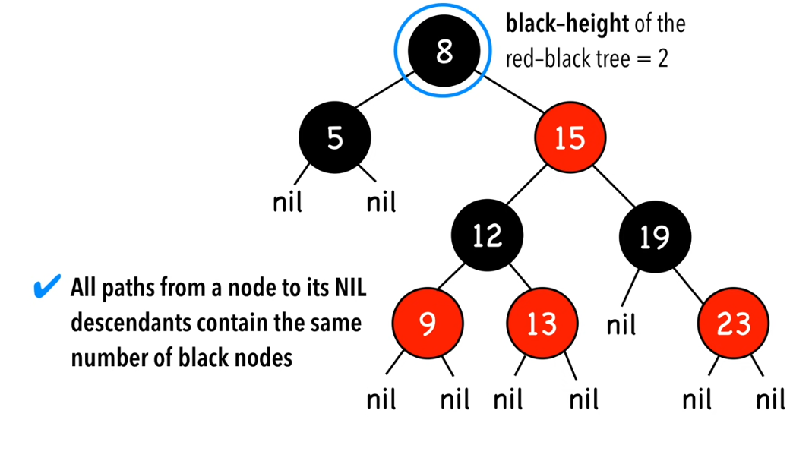
Point 4

Slide 8
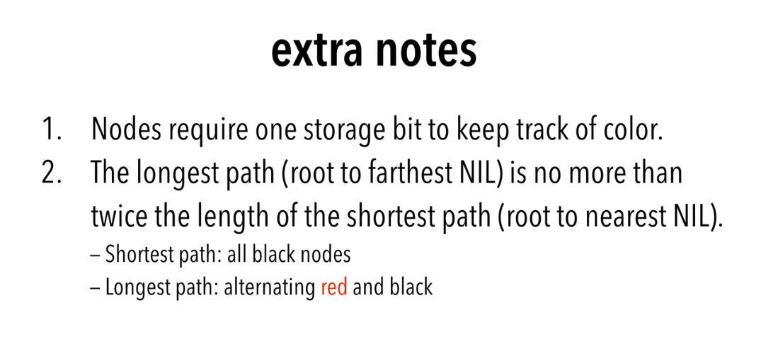

Slide 9
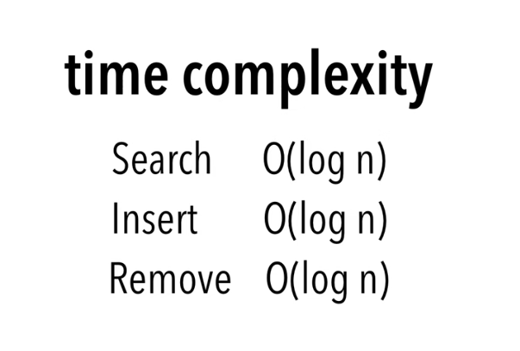
Complexity

Slide 10
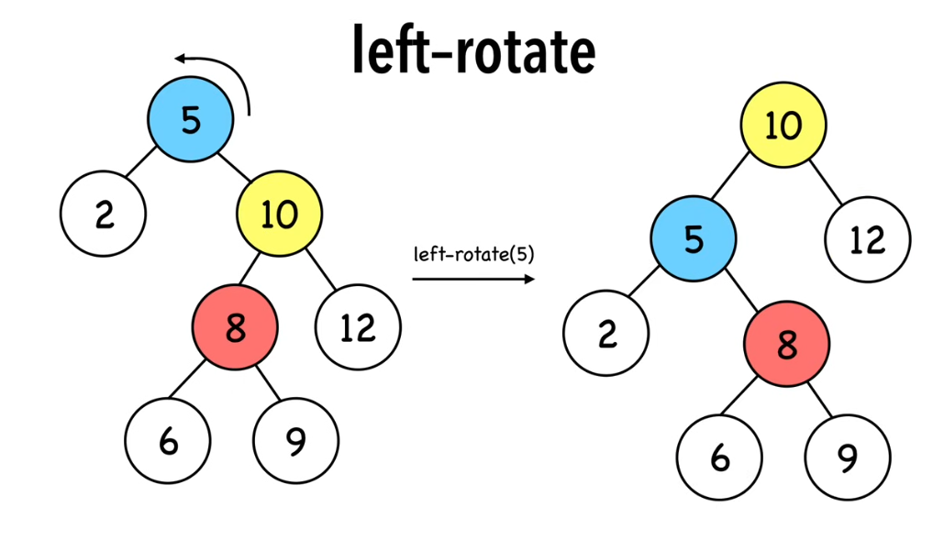
Rotations
Notes:
Complexity O(1)

Slide 11
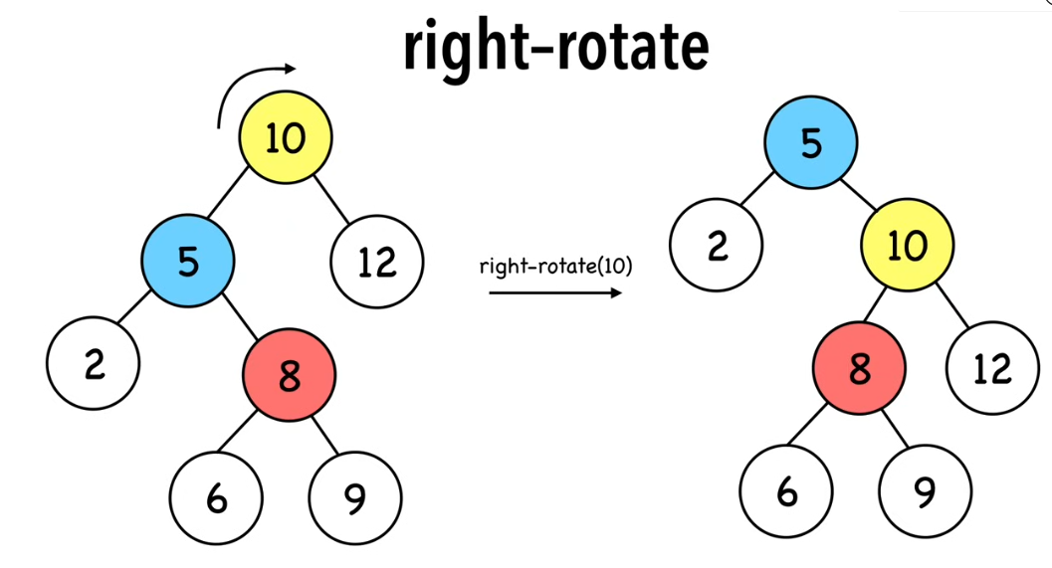
Rotations

Slide 12
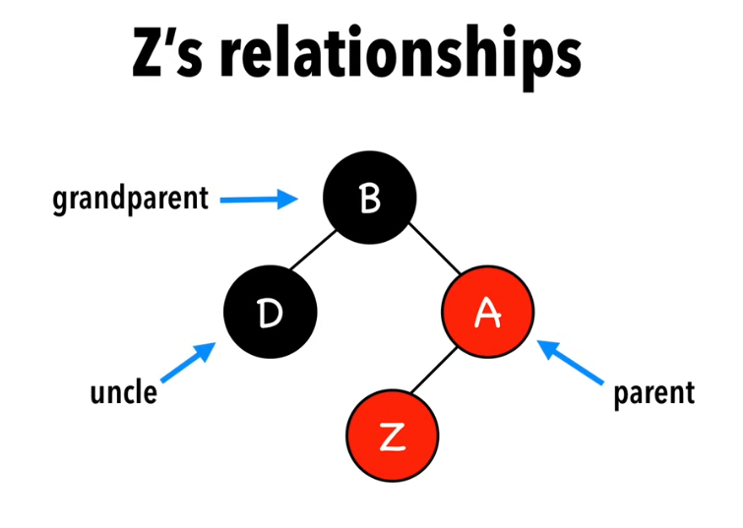
Insertion

Slide 13
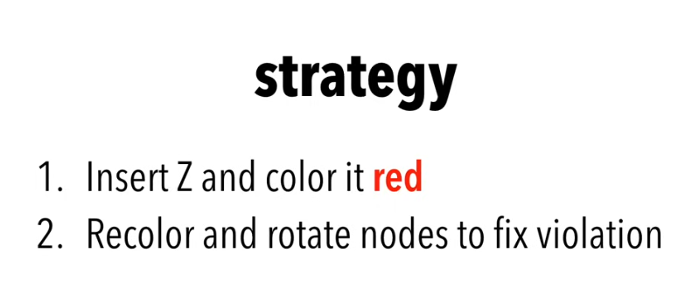
Insertion
Notes:
How to do ‘2’ is explained in next slides

Slide 14
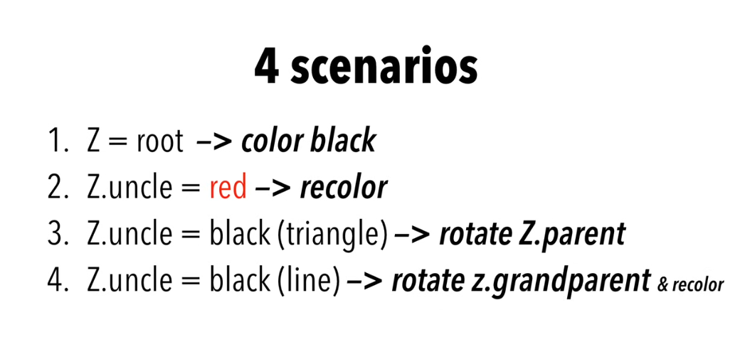
Insertion

Slide 15
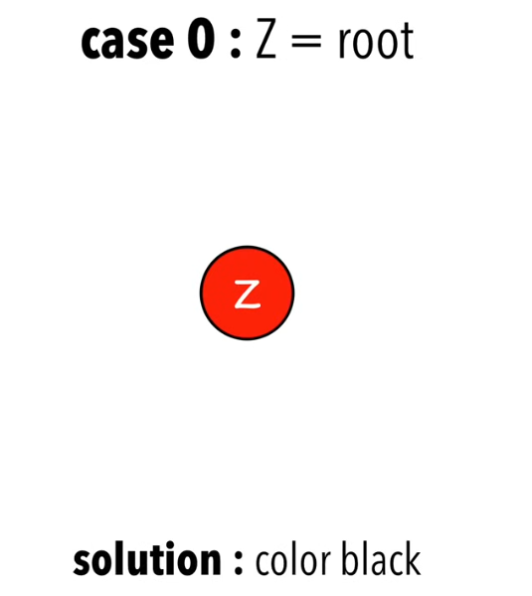
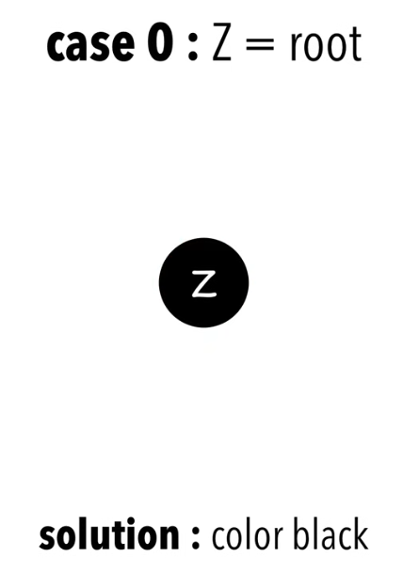
Insertion: Case 0

Slide 16
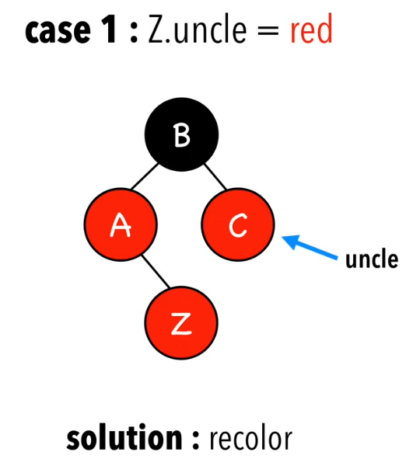
Insertion: Case 1
Notes:
Recolor parent, grandparent and uncle

Slide 17
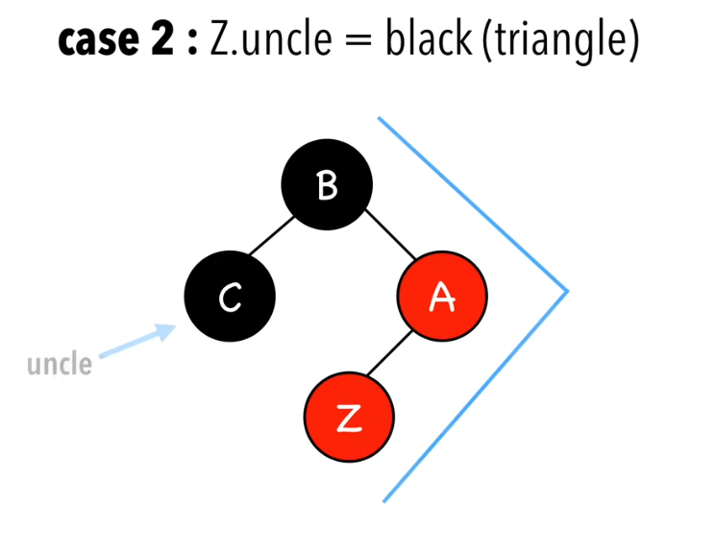
Insertion: Case 2
Notes:
Z, z parent and z grandparent form triangle

Slide 18
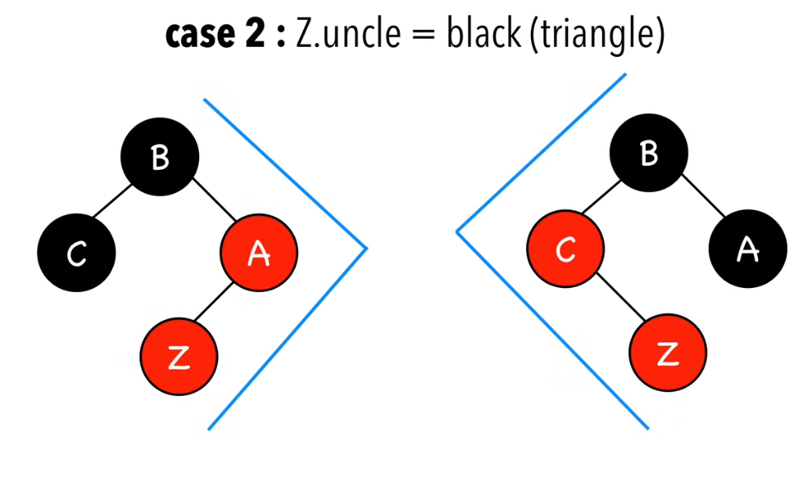
Insertion: Case 2

Slide 19
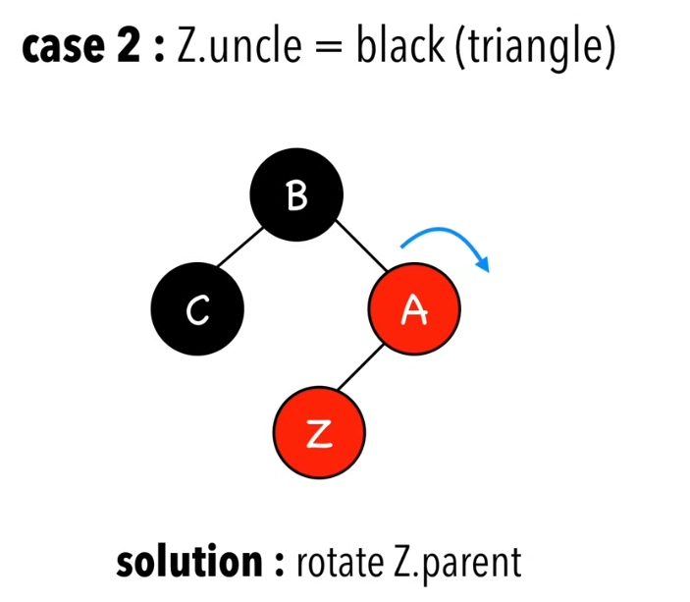
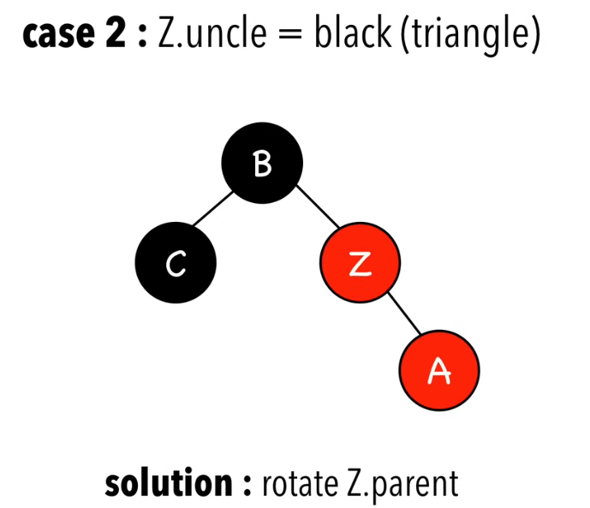
Insertion: Case 2
Notes:
Rotate z parent in the opposite direction of z

Slide 20
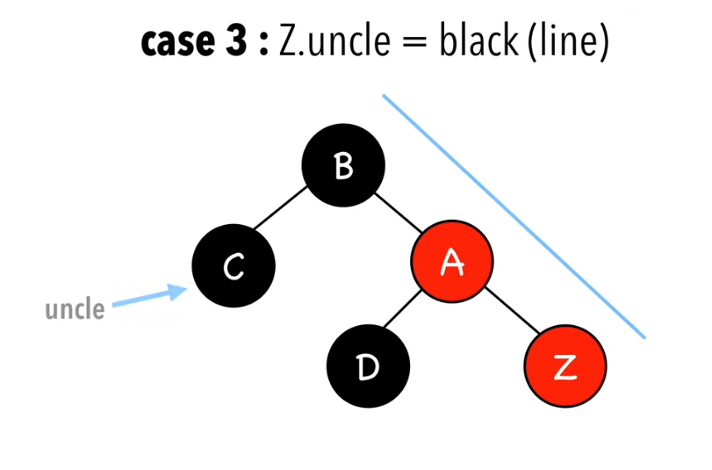
Insertion: Case 3
Notes:
Z, z parent and z grandparent form line

Slide 21
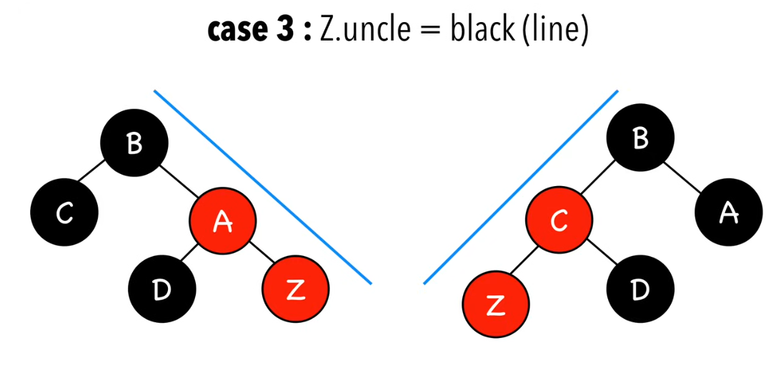
Insertion: Case 3

Slide 22
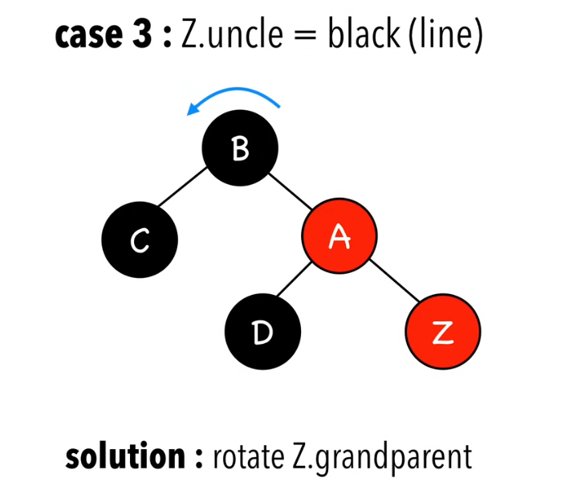
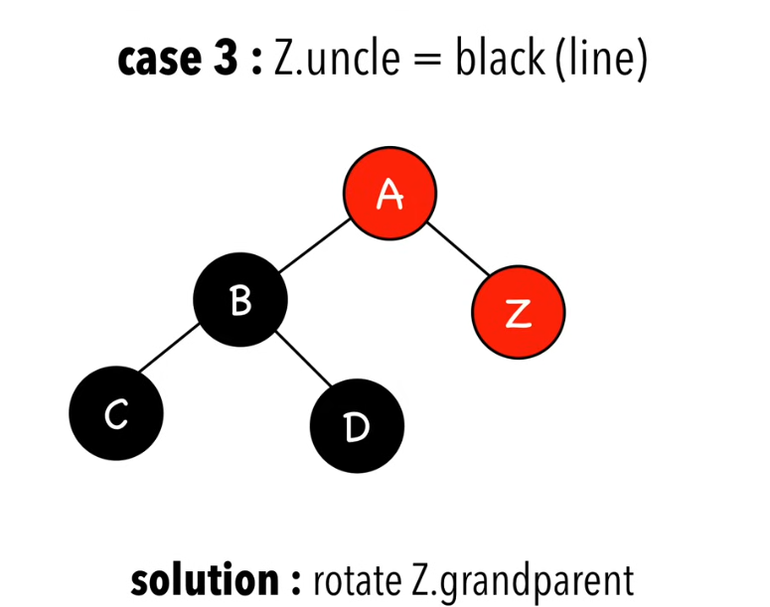
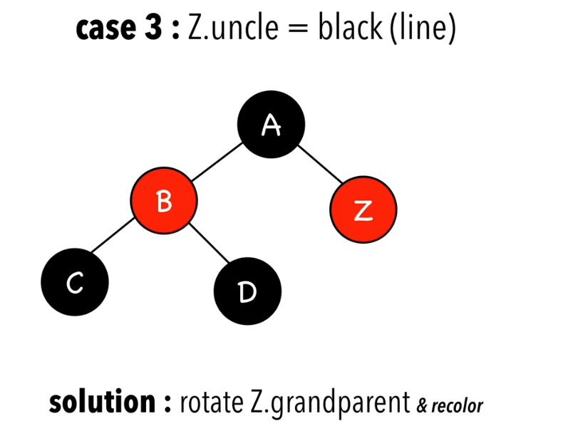
Insertion: Case 3
Notes:
Rotate z grand parent in the opposite direction of z
Recolor original parent and grandparent

Slide 23
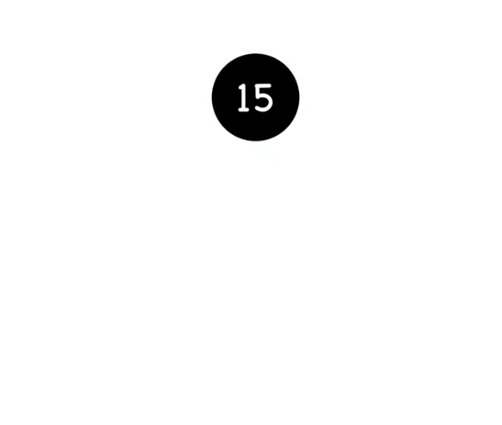
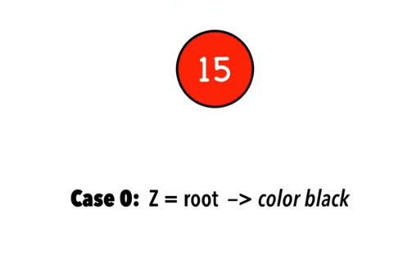
Example of Insertion (15)
Notes:
Recolor the

Slide 24
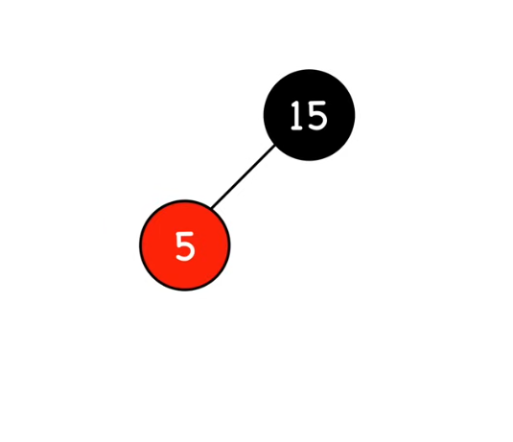
Example of Insertion (5)
Notes:
No violation

Slide 25
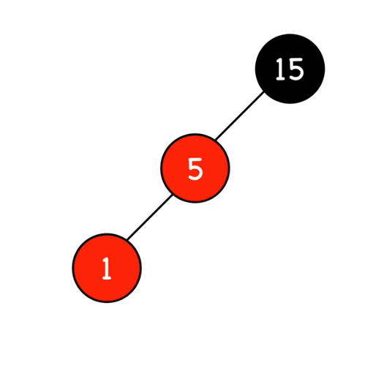
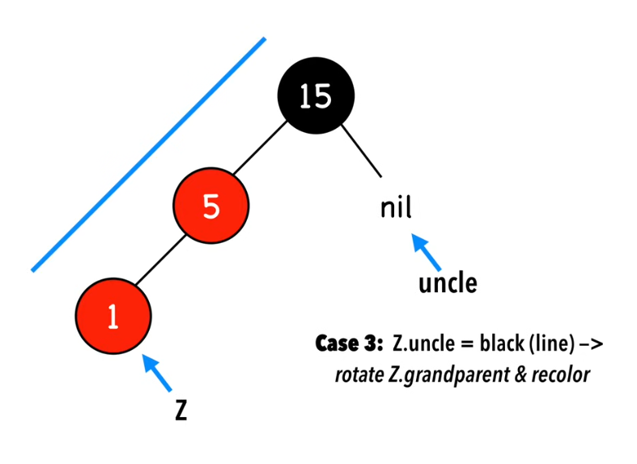
Example of Insertion (1)
Notes:
Violation as two red nodes in a row

Slide 26
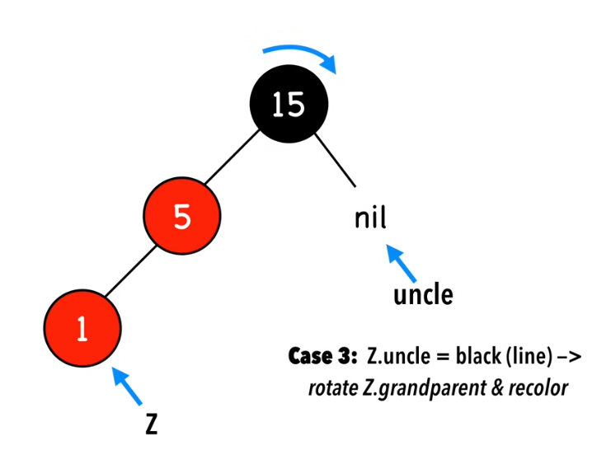
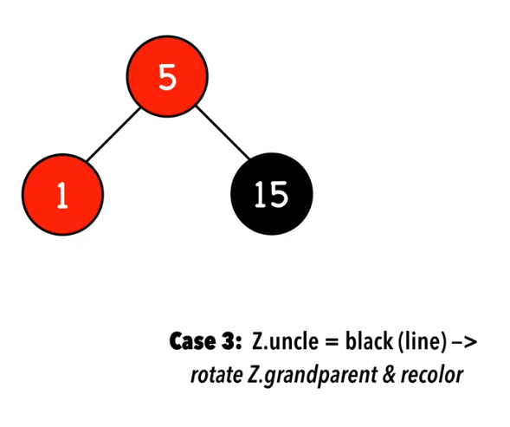
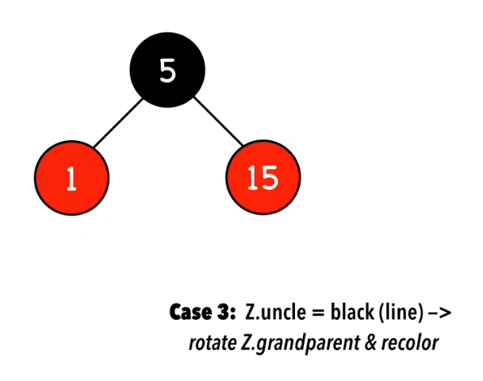
Example of Insertion (1)
Notes:
Rotate 15 in the opposite direction of 1
Recolor parent and grandparent

